Slide 1
Task management with collaboration

Slide 2
Introduction
Managing and monitoring tasks is essential during the any kind of product development process. Handling things manually can be rather chaotic at times, especially when a large number of individuals are engaged.
The "TaskQuest" platform helps users organize and manage team work, get updates, and prioritize reminders.
The system offers important functions such as progress monitoring, process reporting, collaborations, and quick interaction to improve productivity and efficiency. Team members can remain on top of their work and avoid mistakes.
The real-time collaboration features empower teams to work together, share updates, and discuss tasks within the app, enhancing productivity and communication.

Slide 3

Existing System
The features and functionality of existing task management systems differ but they often include tools for project management, work assignment, and progress monitoring.
Some existing system doesn’t have robust and secure platform to work in which security is a concern.
For small teams or users new to platform to work may be overly complex and difficult to learn. It may cost some extra charges to organization.

Slide 4

Need for New System
The new system can be used to manage the cases more accurately and efficiently.
System will provide the report generating, organize tasks, real time updates, get reminders and analysis and many more functionalities.
The need for software that can process information much faster than existing and can therefore help to increase the flow of work and timely availability of information was inevitable. In order to satisfy all above requirement, this software system has been developed and enhanced.

Slide 5
Objectives for New System
The aim of creating the task management web app with collaboration is to deliver an easy, efficient, and scalable solution that improves task organization, team communication.
In order to streamline the task allocation and tracking with team member and provide collaborative feature, the system has been implemented

Slide 6
Problem Definition
“TaskQuest” - Task management and collaboration systems achieve the demands of project processes. It provides a platform and allows features to be worked on “Role based access control” and with real time collaboration behaviour to organise the tasks.

Slide 7
Core components
Admin
Login
Team Member
Register
Team Leader
Login
Generate reports
Manage teams
Manage Tasks
View projects
Manage access
Login
Reset Password
View Tasks
Filter Tasks
Dashboard
Add comment
Manage Profile
Get reminders
Deadline extension
Manage Users
Assign Projects
Add/promote Leader
Manage Permission access

Slide 8
Project Profile
Project Name | TaskQuest
Front-end | ReactJS, Tailwind CSS
Back-end | ExpressJS
Libraries | Material UI
Database | MongoDB
Tools | MS-OFFICE, DIA Builder, creatly
IDE | Visual Studio Code

Slide 9

Assumptions & Constraints
Assumptions:
User must need to understand the system to use the system
Users will have a reliable internet connection to guarantee that real-time collaboration, data synchronization, and communication functions operate properly.
The app assumes an online, real-time environment. Developing an offline mode for users in areas with limited internet access would require additional resources and complex synchronization protocols.
Constraints:
Lack of Backup services
Less Scalability
less payment methods

Slide 10

Advantages & Limitations
Advantages
Enhanced security
organized flow
Visual Dashboards / reports
Limitations
User learning curve
Scalability issues
Low maintance

Slide 11
Requirement Determination
Requirement determination for task management involves gathering, analyzing, and documenting the needs and expectations of stakeholders.
This phase is consisting of:
Surveys & sampling
Client’s requirements
Identifying the non-functional requirements
Review existing system if available

Slide 12
Targeted Users
Team leader
Team member
Admin

Slide 13
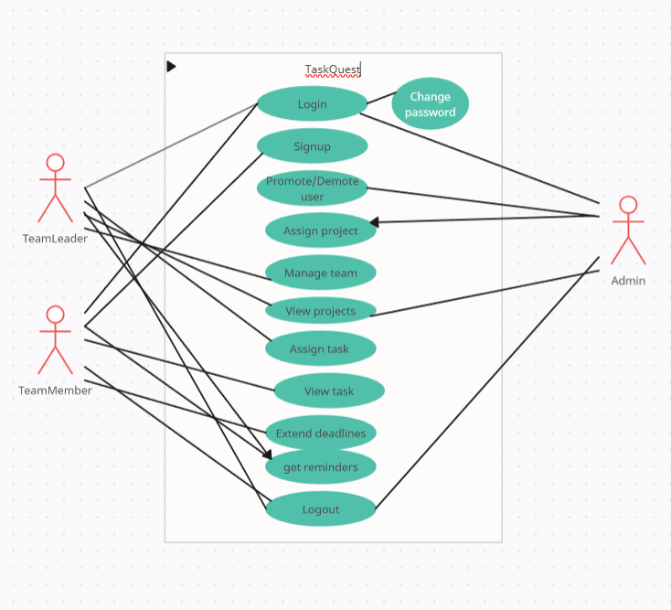
System Design
Use case diagram

Slide 14
Class Diagram

Slide 15
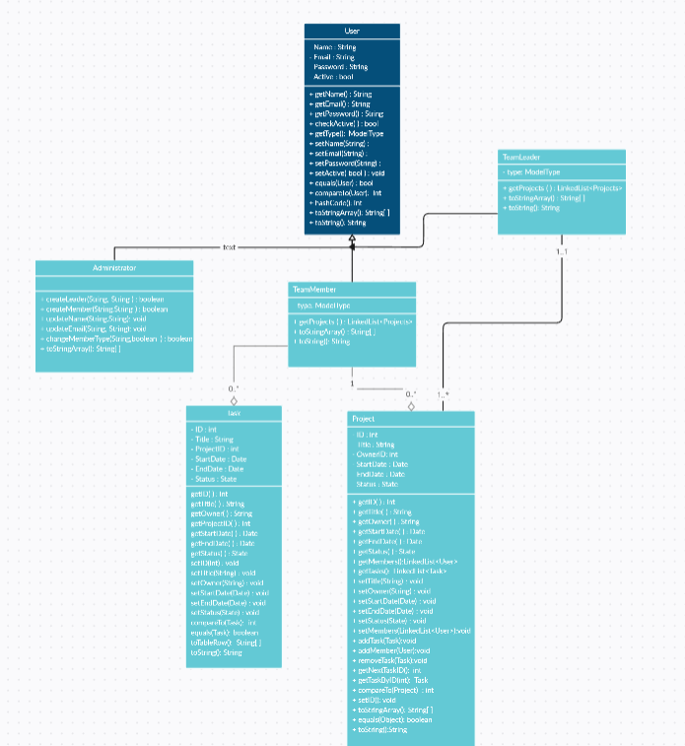

Slide 16
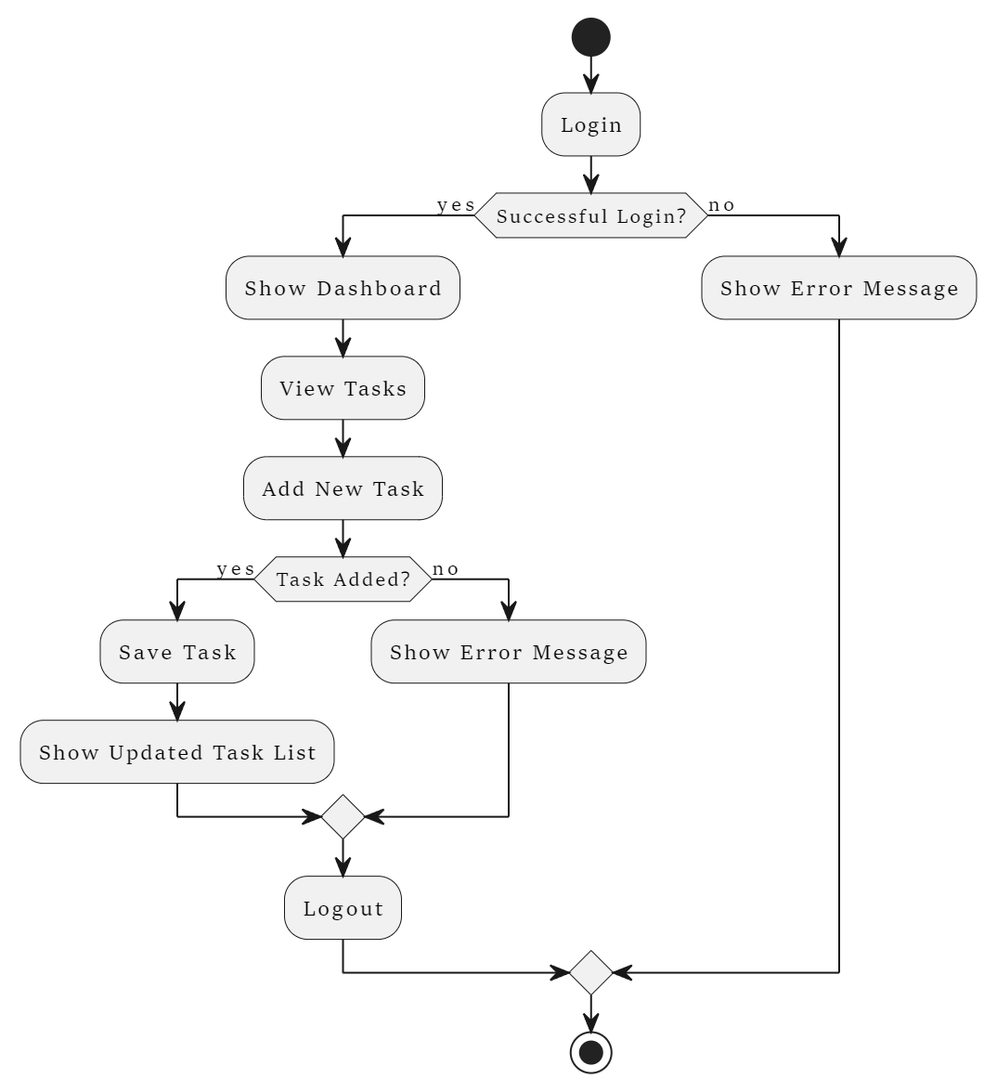
Activity Diagram

Slide 17
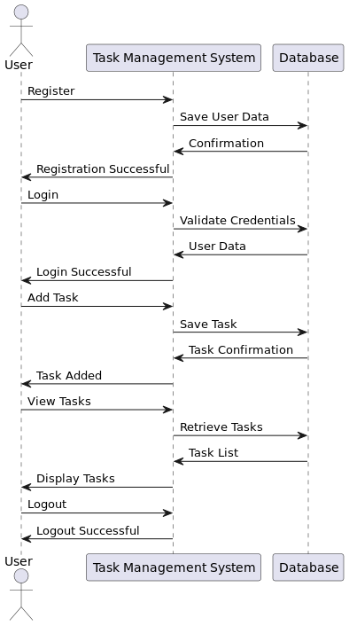
Sequence diagram

Slide 18
Data Dictionary
User table
Field | Datatype | Constraints | Description | Sample
_Id | Object | primary key | Table id | ObjectId(“ 66d0b4a3ab787645b3291b70”)
First name | Varchar2(25) | Not null | Firstname of the user | Arnold
Last name | Varchar2(25) | Not null | Lastname of the user | Macwan
Email | Varchar2(25) | Unique | Email of the user | abc@gmail.com
Password | Varchar2(10) | Not null | Password | abc@123
Userprofile | Varchar2(50) | Not null | Path of image of the user | pics/img.png

Slide 19
Task table
Field | Datatype | Constraints | Description | Sample
taskId | Object | Primary Key | Unique identifier for the task | ObjectId(“12c0b...”)
title | Varchar(50) | Not null | Title of the task | Design UI
description | Text | Not null | Detailed description of the task | Design the login UI
status | Varchar(10) | Not null | Current status of the task | Pending
priority | Varchar(10) | Not null | Priority level of the task | High
dueDate | Date | Not null | Due date for the task | 2024-09-10
assignedTo | Foreign Key | Not null | Links the task to the assigned user | userId

Slide 20
Team table
Field | Datatype | Constraints | Description | Sample
Id | Object | Primary Key | Unique identifier for the team | ObjectId(“12c0b...”)
Team_name | Varchar (50) | Not null | name of the team | Frontend Team
Members | Varchar (50) | Not null | List of the members | [user1,user2]

Slide 21
Comment table
Field | Datatype | Constraints | Description | Sample
Id | Object | Primary Key | Unique identifier for the table | ObjectId(“12c0b...”)
Author | Foreign key | Foreign key references user table | Links to the user who wrote the comment | userid
Date | Date | Not null | Date of the comment received | 20-04-2024
Message | Varchar (250) | Not null | Message description | It was good

Slide 22
Project table
Field | Datatype | Constraints | Description | Sample
Id | Object | Primary Key | Unique identifier for the table | ObjectId(“12c0b...”)
Name | String | Not null | Name for the project | Chatify
Teams | Array | - | Stores the teams associated with project | [t1,t2]
Assigned to | String | Not null | Stores the detail of leader project assigned to | John Doe
Created_at | Date | Default | Timestamp at time of creation | 12-05-2023
Status | String | - | Status of project | Delayed
Due date | Date | - | Deadline date for the project completion | 12-07-2024

Slide 23
Development
Coding standard
Project structure:
Use clear and descriptive names for the whole directory of the project and also recommend the naming conventions rules for the variables and functions names.
Code-version management:
Use a version control system (i.e., GitHub) for the project to collaborate effectively.
UI design:
Design a user-friendly interface so that user can use the system and understand it easily.
Error handling:
Implement an error free code and use error handling mechanism for user interactions.
Further development:
Maintain the system as well conduct regular reviews that genuine feedback for the system.
Always look for the further improvement of the system that can make the system work more accurate and reliable

Slide 24
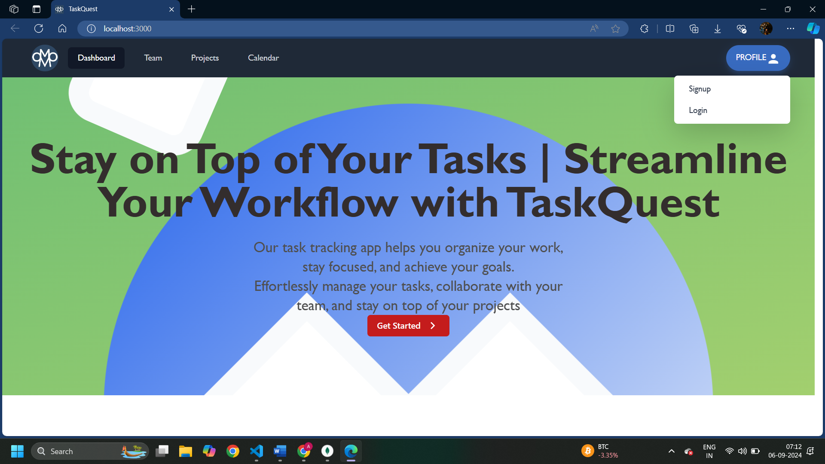
Screenshots
Home screen

Slide 25
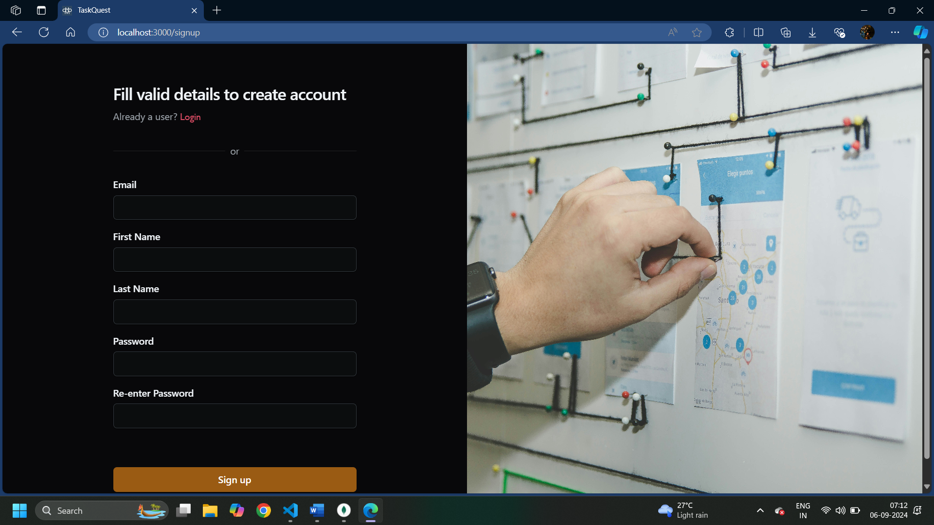
Signup screen

Slide 26
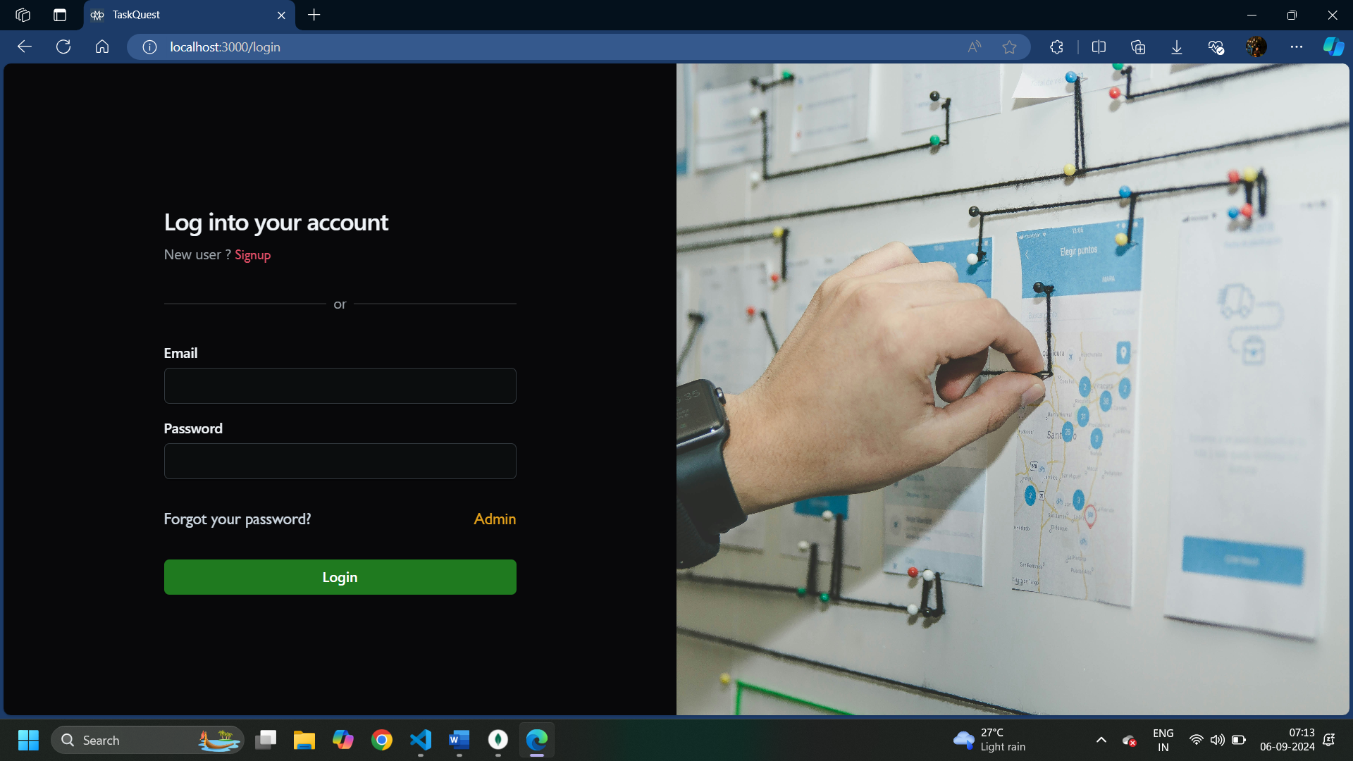
Login screen

Slide 27
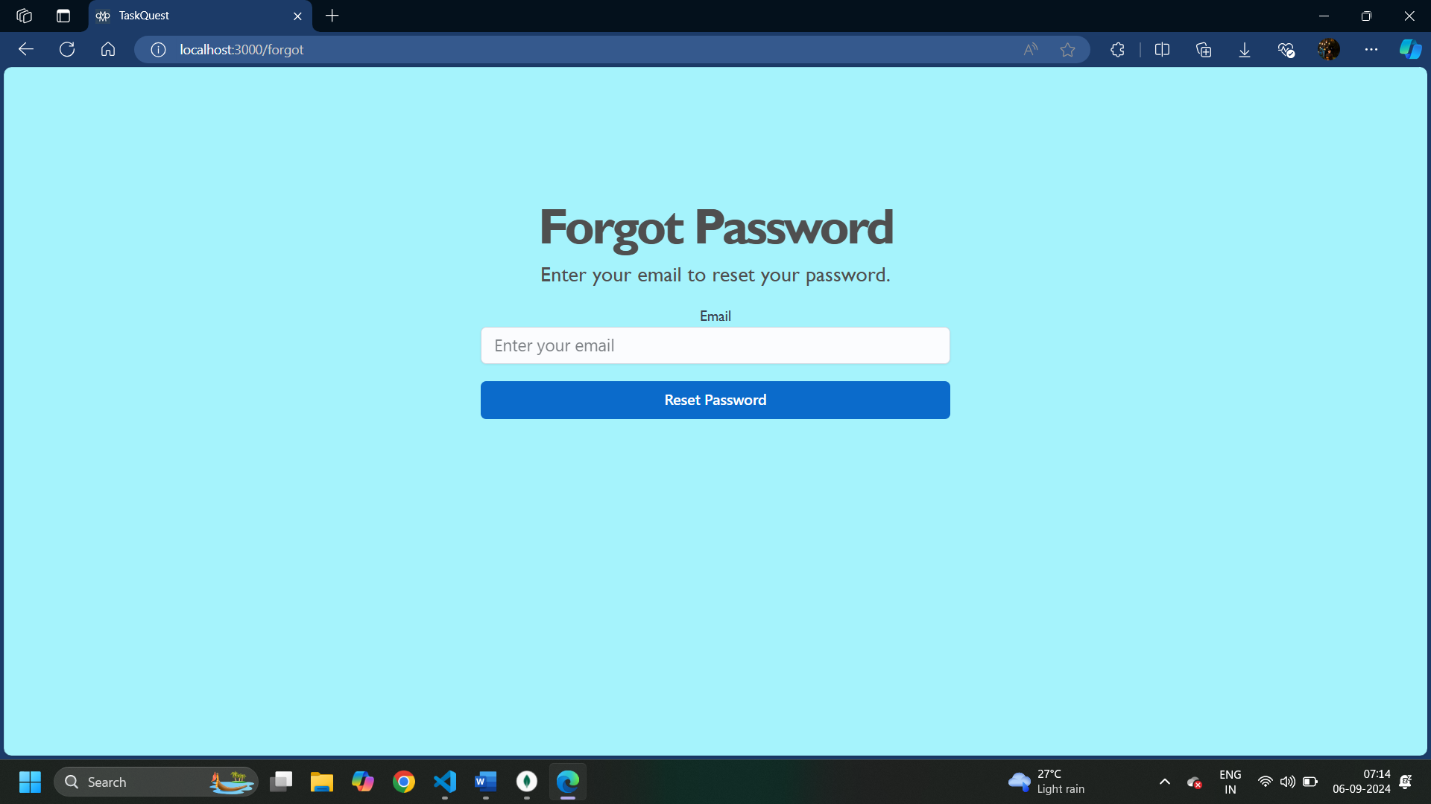
Forgot password

Slide 28
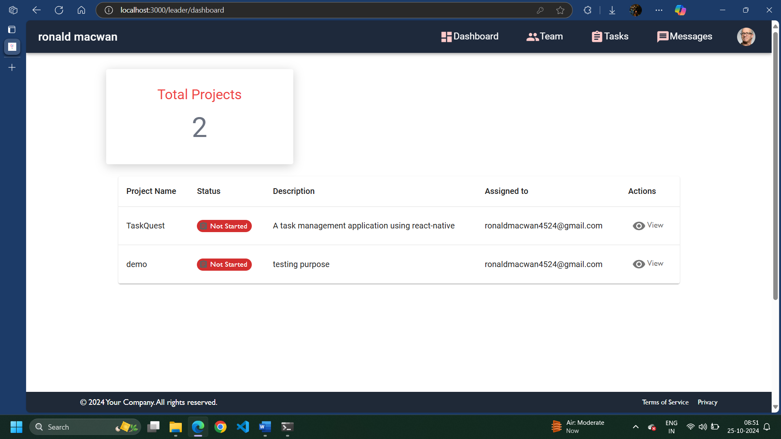
Team leader dashboard

Slide 29
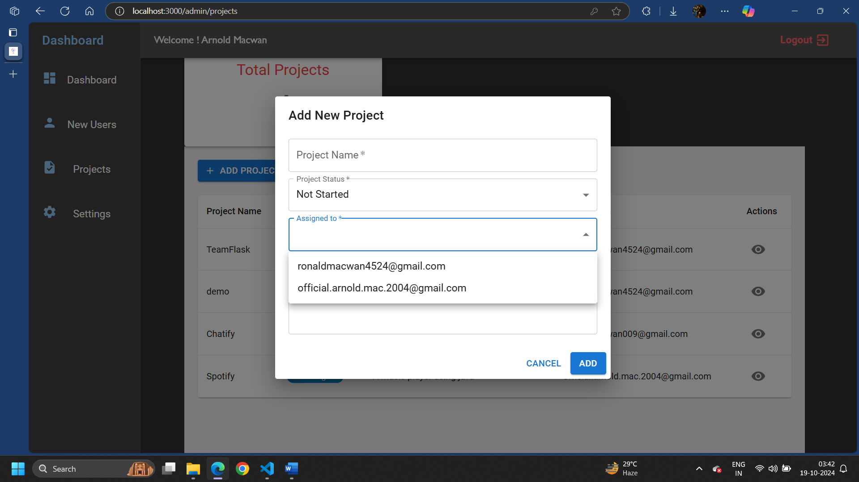
Add project

Slide 30
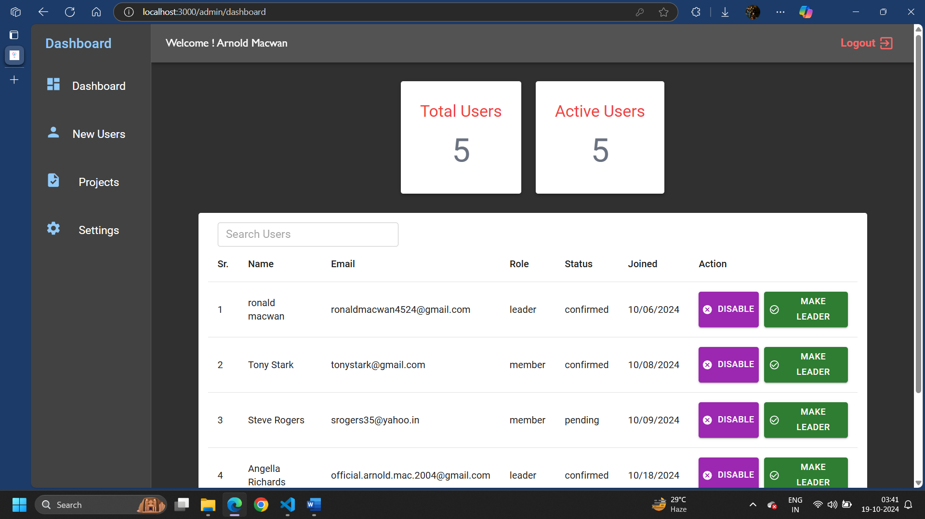
Admin dashboard

Slide 31
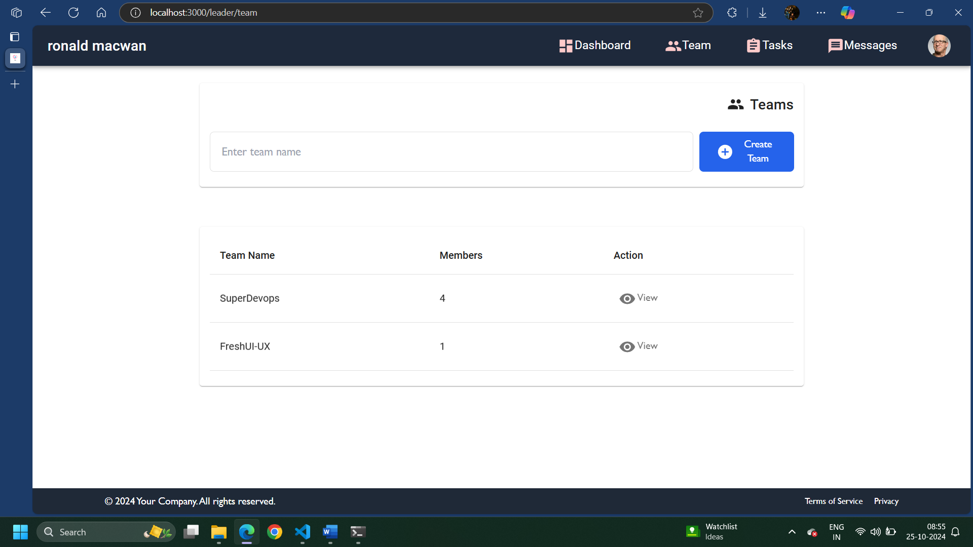
Team list

Slide 32
Proposed enhancement
System is focusing on resolving current issues and enhancing functionality.
Improvements include more data security, efficient analytics using machine learning.
Implement Role based access control.
Going to add basic real time chat in the system.

Slide 33
conclusion
A task management system is essential for improving product development, data security, and real time collaborations. we aim to deliver a more efficient, user-friendly, and scalable solution.

Slide 34
Thank you

